Slide 1
AUTOMATED TAILGATING DETECTION SYSTEM
PROJECT FOR VMWARE CAMPUS AMBASSADOR PROGRAM: VIRTUAL HACKATHON
Done by:
Team Guardians: Moyank Giri, Tarun Aditya
4th Semester
Computer Science
PES University

Slide 2
Today's Presentation
Contents:
Problem statement
Introduction
Proposed Solution
Object Detection
i. Single Shot Detectors
Object Tracking
Tailgating Detection
Architecture and Results
Setup Description
Inputs
Tailgating Detection
Outputs
Advantages and Challenges
Additional Features and Future Works
AUTOMATED TAILGATING DETECTION SYSTEM 1

Slide 3
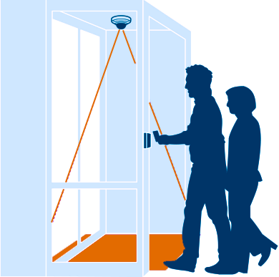
1. Problem Statement
Given a CCTV camera footage of a secured door entry
detect anyone tailgating using an automated system.
The system should segment individuals from the video and detect whether they are tailgating or not
AUTOMATED TAILGATING DETECTION SYSTEM
2

Slide 4
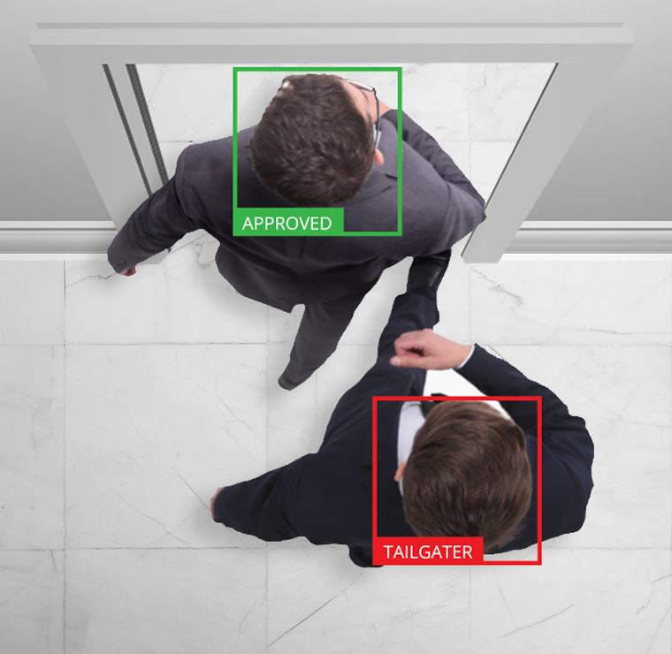
2. Introduction
Proposed solution is implemented in full and presented in further slides
Security breaches known as tailgating
also referred to as piggybacking.
unauthorized person follows an authorized individual to enter a secured area.
Results in
huge revenue loss
threats to privacy and safety.
Cause:
common courtesy
simply following a person through doors
Present Solutions:
Simple Motion Detection Video Approach
Cameras and mirror method
Proposed Solution
Computer Vision based Approach
Object Detection: Single Shot Detector
Object Tracking: Centroid Tracking Algorithm
Tailgating Detection
AUTOMATED TAILGATING DETECTION SYSTEM
3

Slide 5
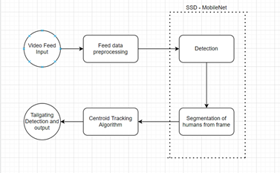
3. Implemented Solution
Computer Vision Based Solution
3 phases implementation:
Object Detection
Object Tracking
Tailgating Detection
AUTOMATED TAILGATING DETECTION SYSTEM
4

Slide 6
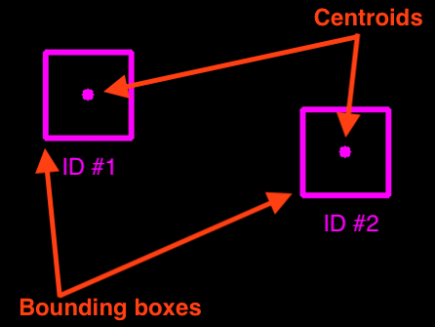
3a. Object Detection
Multiple objects detected using single shot
For each object detected
create an object tracker with the bounding box coordinates
then find the centroid of each object detected
Above steps are done using
Single Shot Detector (SSD)
AUTOMATED TAILGATING DETECTION SYSTEM
5

Slide 7
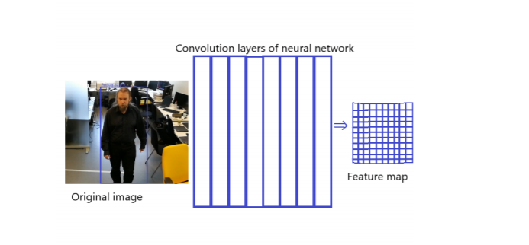

3ai. Single Shot Detector
Object Detection: Single Shot Detector (SSD)
What is SSD
used in object detection and classification on images.
running the convolutional network once on the input image
This forms a feature map.
Formation of bounding boxes for the recognized objects
These bounding boxes have different sizes and aspect ratios.
Each bounding box represents a detected human.
SSD Working Principle
AUTOMATED TAILGATING DETECTION SYSTEM
6

Slide 8
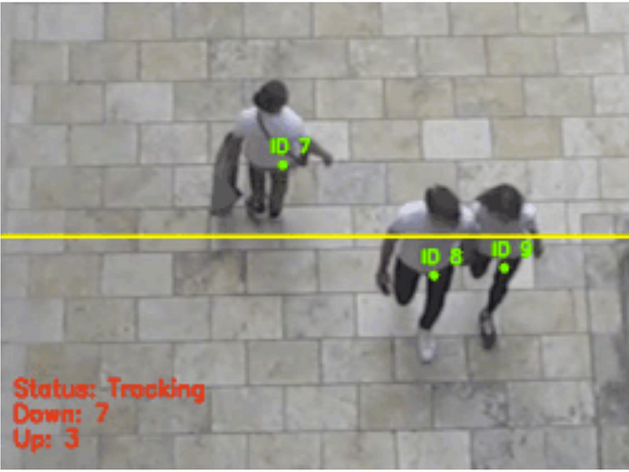
3b. Object Tracking
Object tracking is done using the centroid associated with each objects.
Tracking algorithm relies on the Euclidean distance
Euclidean distance between centroids in subsequent frames is calculated
The primary assumption of the centroid tracking algorithm is that centroids must lie close together between subsequent frames.
AUTOMATED TAILGATING DETECTION SYSTEM
7

Slide 9
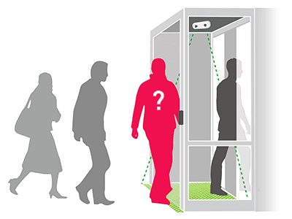
3c. Tailgating Tracking
An imaginary line would be used to mark the gate region
The line coordinates will be sent to the backend of the app where the live feed is being processed
The line will be used as a line of reference across which tailgating can be detected.
The number of people passing through the gate in the frame is compared with the number of authorized entries
Mismatch in number raises an alert
The number of authorized entries is equal to the number of card entries at any particular time
AUTOMATED TAILGATING DETECTION SYSTEM
8

Slide 10
Architecture and Results
Setup description:
Over the head camera
Virtual gate
Card reader
Inputs:
Video stream for object detection
Card Swipe inputs
Tailgating Detection process
Object Detection
Object Tracking
Alert on Tailgating
Outputs:
Video warning
Audio based warning
Log file
AUTOMATED TAILGATING DETECTION SYSTEM
8

Slide 11
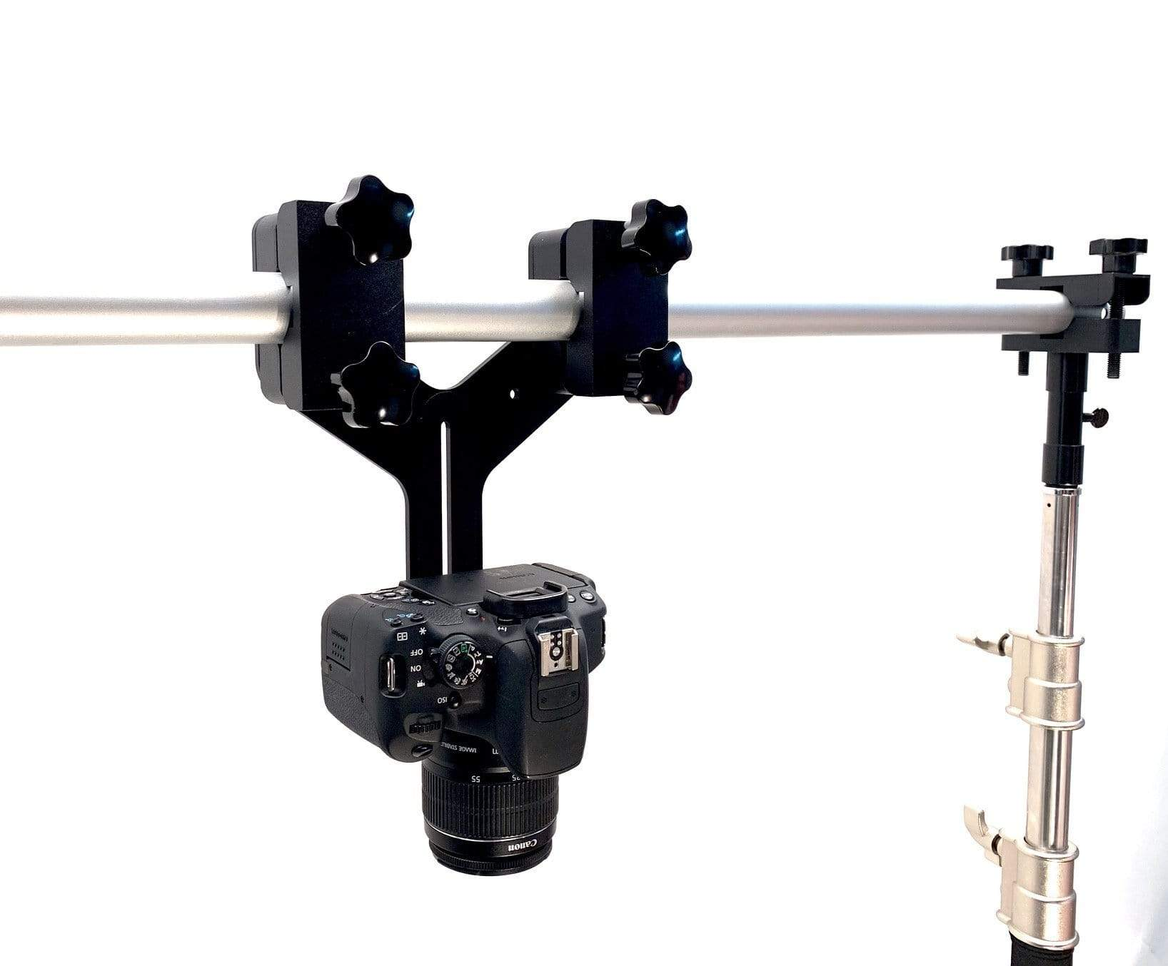
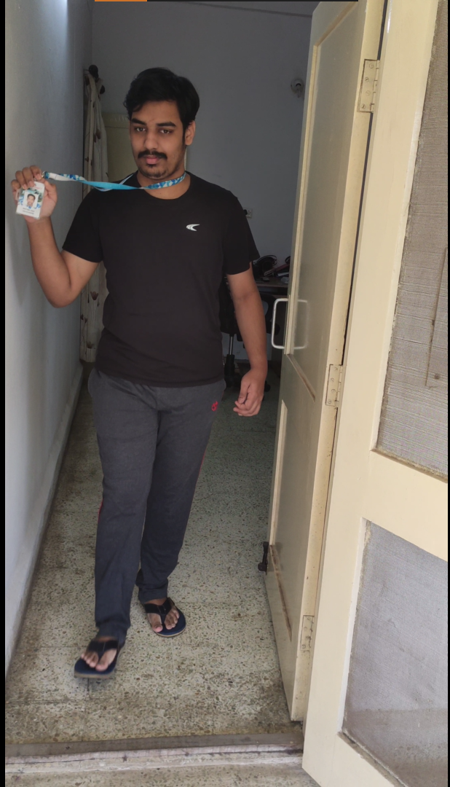
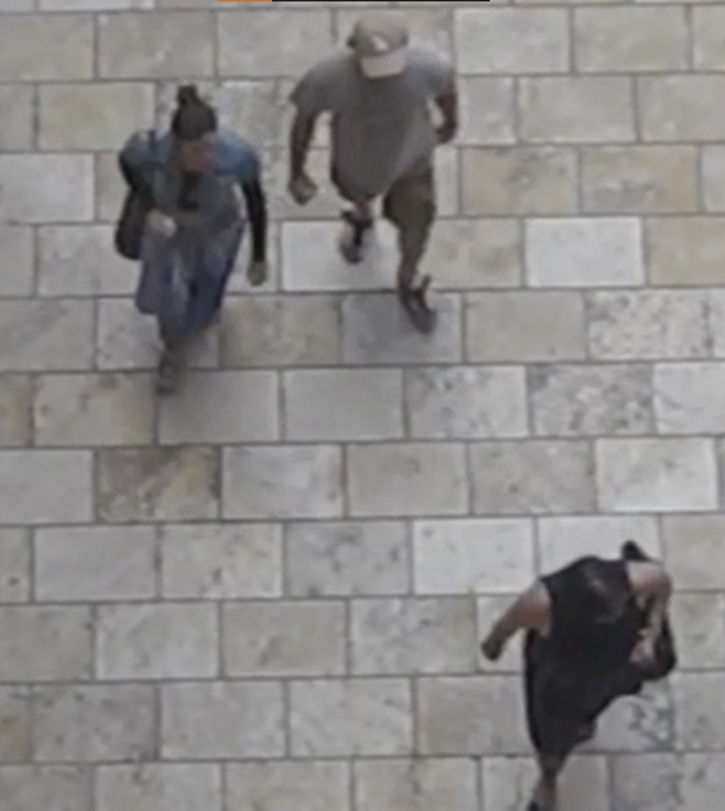
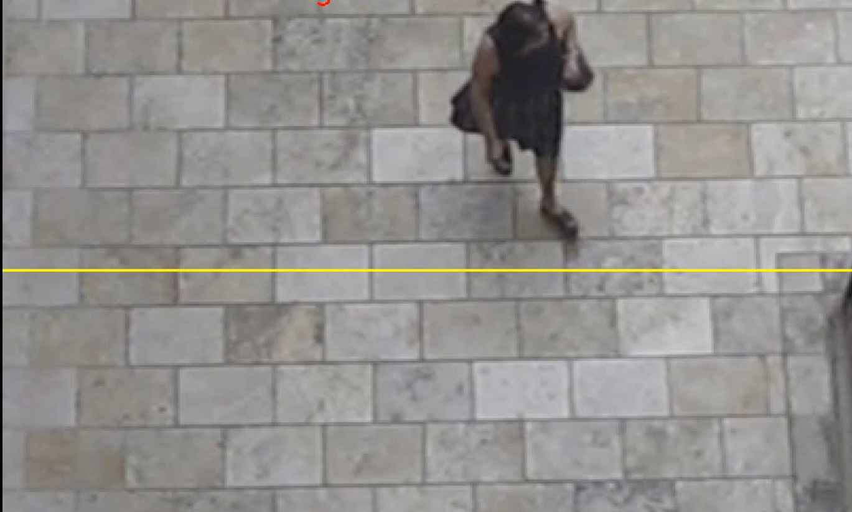
Setup Description
Card reader outputs:
0 => No card read
1 => Card read
2. Overhead Camera
3. Virtual gate
Virtual Gate
AUTOMATED TAILGATING DETECTION SYSTEM
8

Slide 12
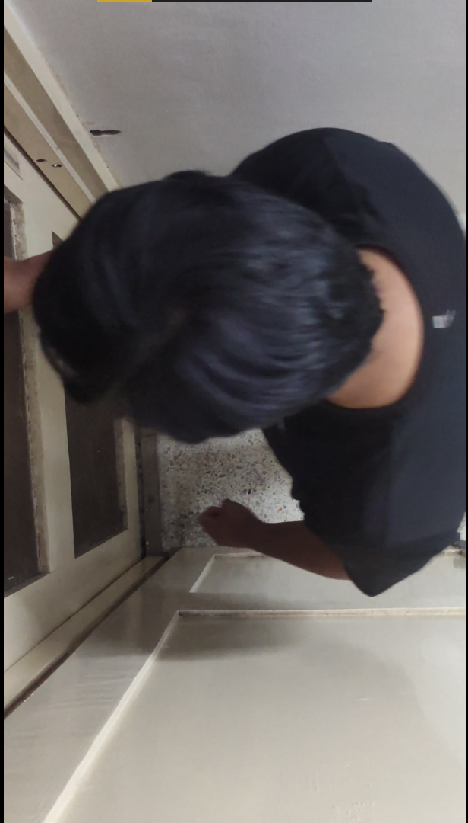
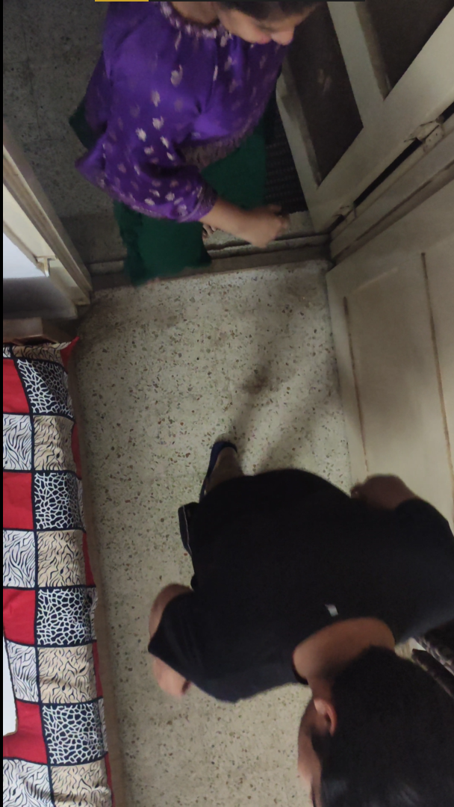
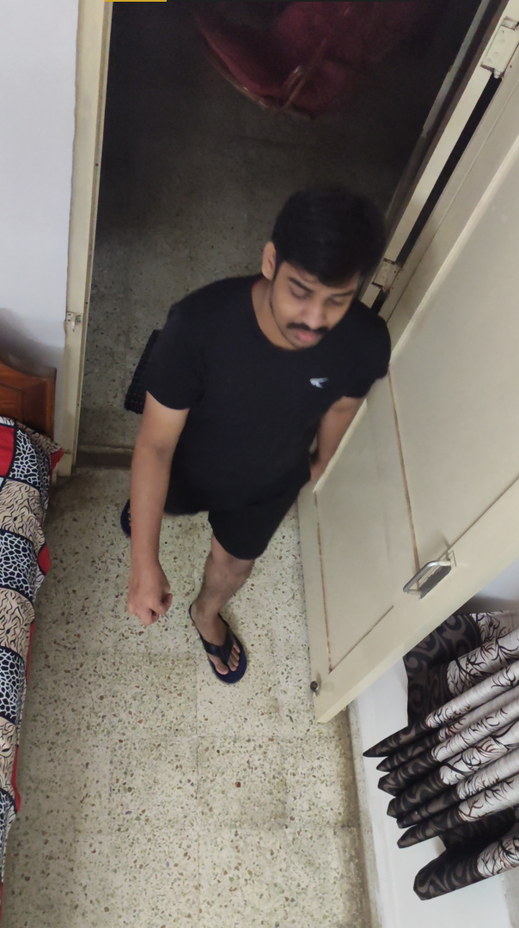
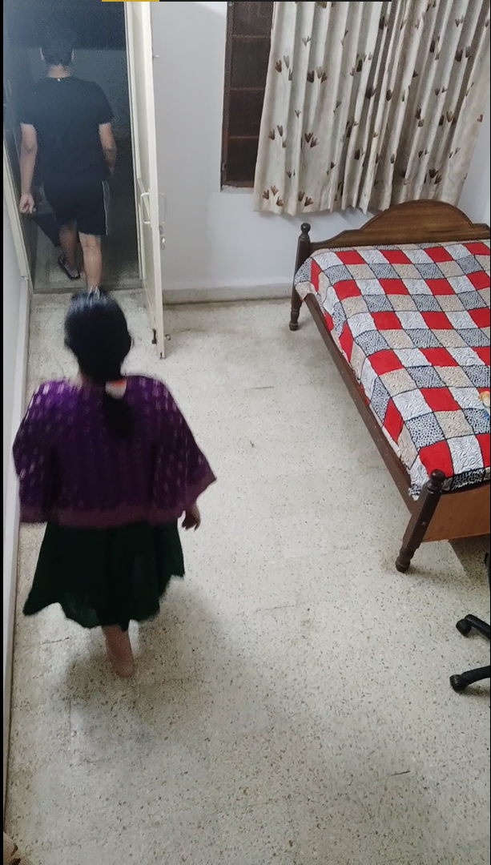
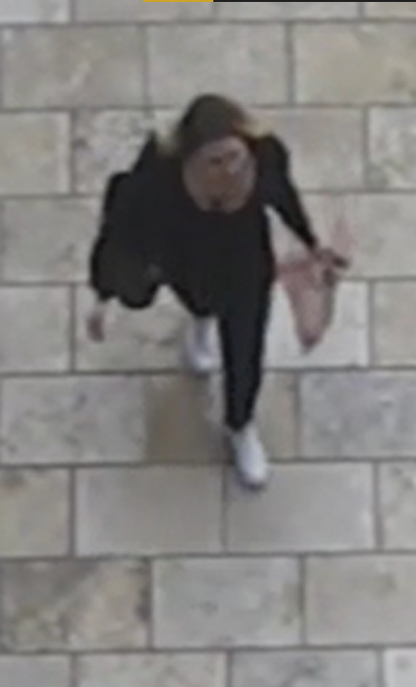

Inputs
Video stream for object detection
Made use of own set of videos to test and validate the detection
Used 5 sets of video ; 4 generated by own camera
Card Swipe inputs
Represented using CSV file
0 – No card swipe 1 – Card Swipe
AUTOMATED TAILGATING DETECTION SYSTEM
9

Slide 13
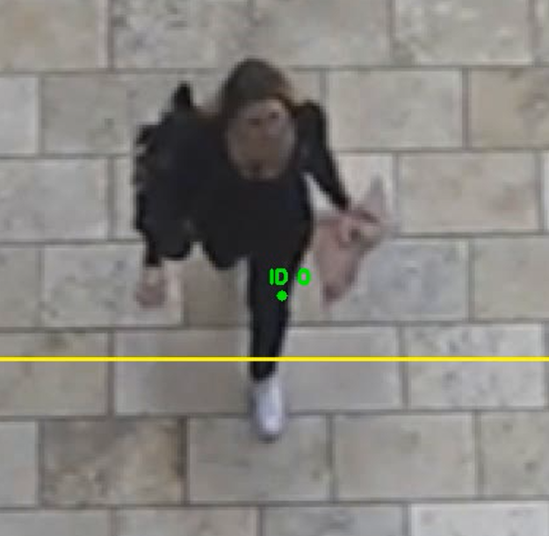
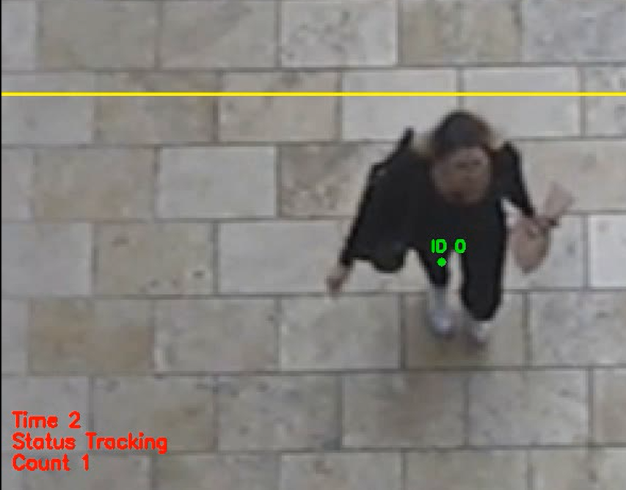
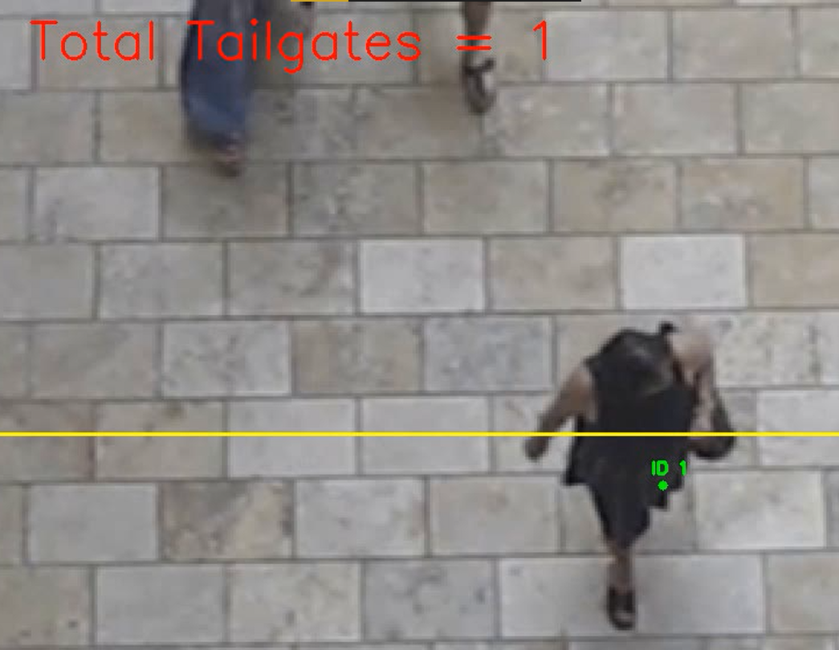
Tailgating Detection Process
Object Detection
(Detected Object shown with green point)
Object Tracking
(Tracked using direction of movement and indicated below (Count))
Alert on Tailgating
(Number of tailgates alerted on video too )
AUTOMATED TAILGATING DETECTION SYSTEM
8

Slide 14

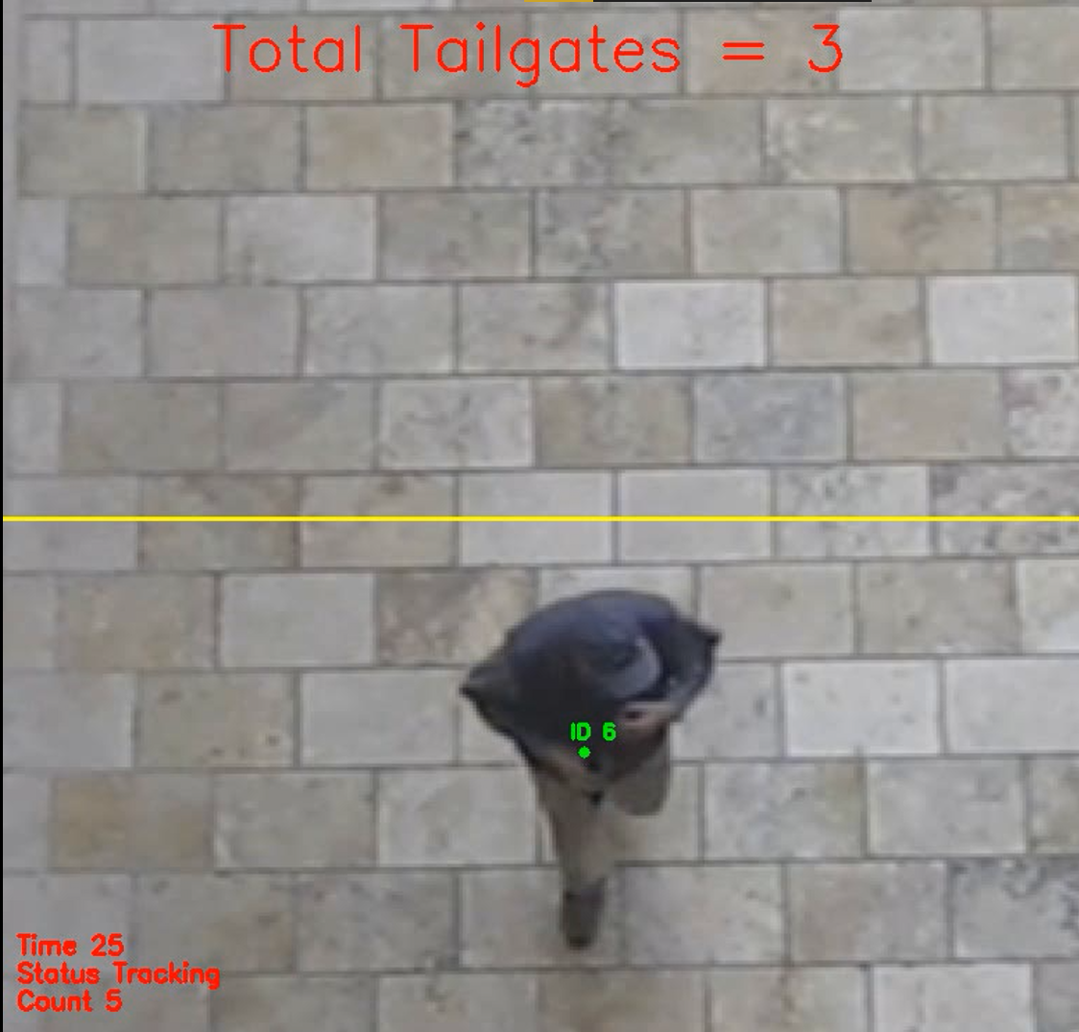

Outputs
Log files showing
total count of entries
card entries per sec
Video warning
Displayed on top of video
Audio based warning
Beep Sound generated for tailgating detection
AUTOMATED TAILGATING DETECTION SYSTEM
8

Slide 15
4. Advantages and Challenges
Advantages:
Our software would be easily configurable by anybody
Can be used for any video feed in general
User friendly
Can detect with high accuracy and speed
Challenges:
Identifying humans even if they have some accessory(such as a person wearing a helmet or a cap)
This approach cannot detect cases where a person carrying another person on their shoulders or in some other way.
AUTOMATED TAILGATING DETECTION SYSTEM
9

Slide 16
5. Additional Features and Future Works
Facial Recognition: We can also add facial recognition as a feature if the employee database consists of pictures of each employee and these pictures can be provided to us in order to not only detect the person who is tailgating but also release the picture of the intruder detected to the necessary authorities and also to verify (if possible) whether the intruder is someone in the database or not.
AUTOMATED TAILGATING DETECTION SYSTEM
10

Slide 17
Thank you
Any Queries?

